Slide 1
Statistics Q&A Discussion

Slide 2
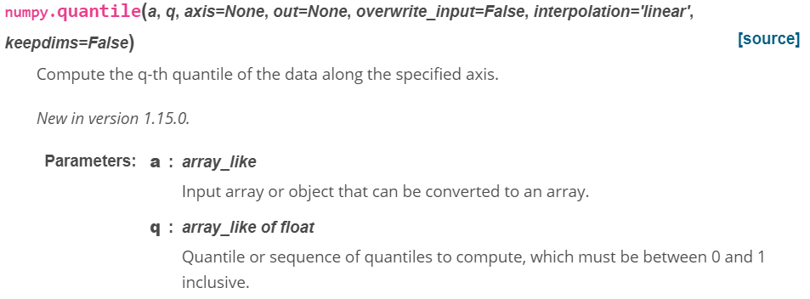
Q&A Is np.quantile inclusive or exclusive of the quartile values Ans. Numpy - Inclusive by default Statistics package – exclusive by default
statistics.quantiles(data, *, n=4, method='exclusive')

Slide 3
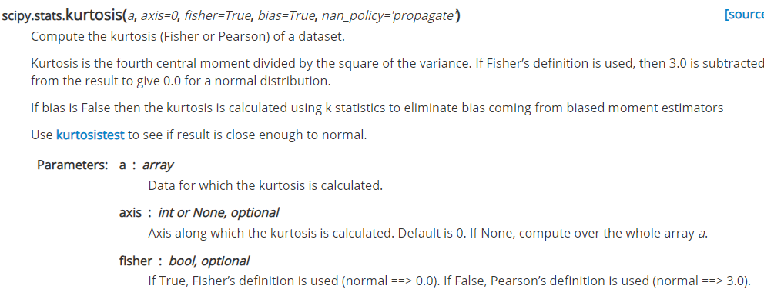
Q&A Why is the df.kurt result for a normal distribution showing as a value near 0 (instead of value near 3)?
DataFrame.kurt
Returns unbiased kurtosis over requested axis.
Kurtosis obtained using Fisher’s definition of kurtosis (kurtosis of normal == 0.0). Normalized by N-1.
As Fisher’s definition is used, 3.0 is subtracted from the result to give 0.0 for a normal distribution.

Slide 4
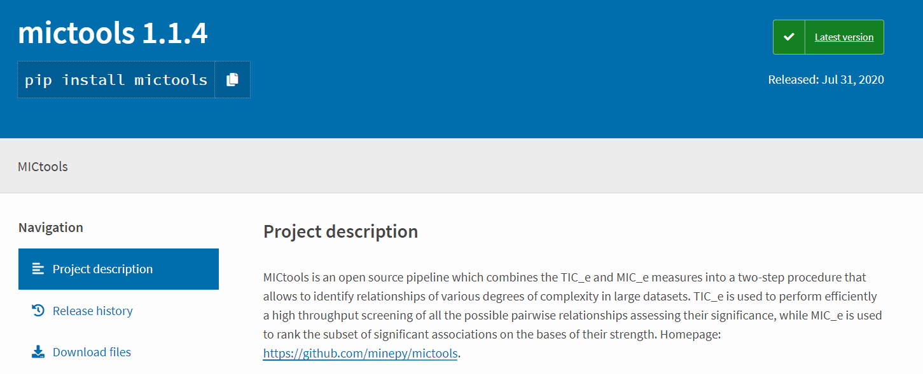
Q&A Is there a correlation measure to determine non-linear relationships between variables?
Maximal information Coefficient (Reshef , Reshef et al 2011) is an information theory-based measure of association that can capture a wide range of functional and non-functional relationships between variables.
Able to capture wide range of linear and non-linear relationships (cubic, exponential, sinusoidal, superposition of functions)
https://medium.com/@rhondenewint93/on-maximal-information-coefficient-a-modern-approach-for-finding-associations-in-large-data-sets-ba8c36ebb96b

Slide 5
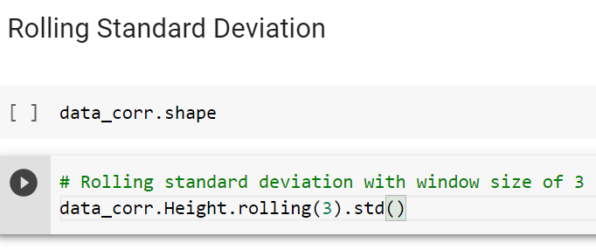
Q&A
Included rolling standard deviation code in Statistics in-class notebook
Reference: https://pandas.pydata.org/docs/reference/api/pandas.core.window.rolling.Rolling.std.html

Slide 6
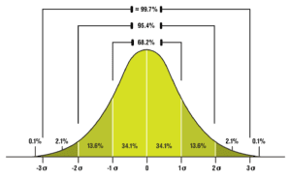
Q&A
Six Sigma
The program’s name comes from the area under the normal distribution curve, after moving six standard deviations away from the center (three σ in each direction).
Moving one standard deviation away from zero (the graph’s center) covers about 34.1% of the data. Moving one standard deviation away from zero in each direction (2σ) therefore covers twice as much, or 68.2% of the data.
Two standard deviations in either direction (4σ) covers 95.4% of the data.
Three standard deviations in either direction (6σ) covers roughly 99.7% of the data.
The goal here is to achieve what is commonly known as “Six Sigma Quality” or defect rates that fall outside the 6σ range. These defect rates are measured in the units DPMO, or defects per million opportunities.
In other words, approximately 99.7% of the data points will consist of output with zero defects.

